Slide 1


[Organization / assessor logos]
Agri CP Tool
Client Protection Standards for the Agricultural Sector
[Organization name – Country]
Agri CP Tool results & recommendation presentation
[Date – by Name]
[Version: August 2026. Draft version, under development]
cerise-sptf.org

Slide 2
Introduction
[Describe the context of the assessment, the date of the field mission, etc,]
[Describe the main activities realized by the consultant]

Slide 3
Objectives of the assessment
Identify and prioritize gaps in how smallholder farmers are protected.
Reduce overindebtedness and reputational risk.
Raise awareness and built the capacity of your internal teams.
Increase smallholder farmer trust and loyalty through fair treatment.
Meet investor and lender client protection requirements.
Align with international client protection standards.

Slide 4
Agri CP Assessment Results for [name of agricultural organization]

Slide 5
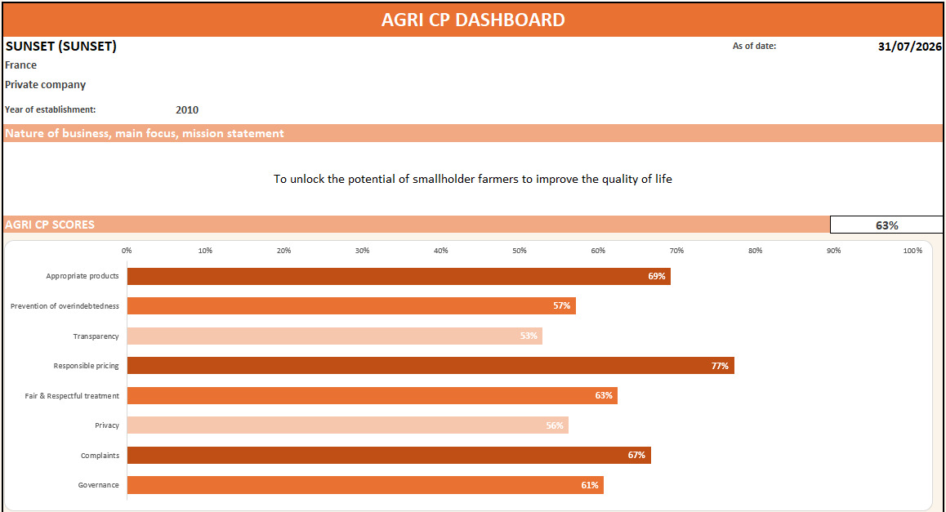
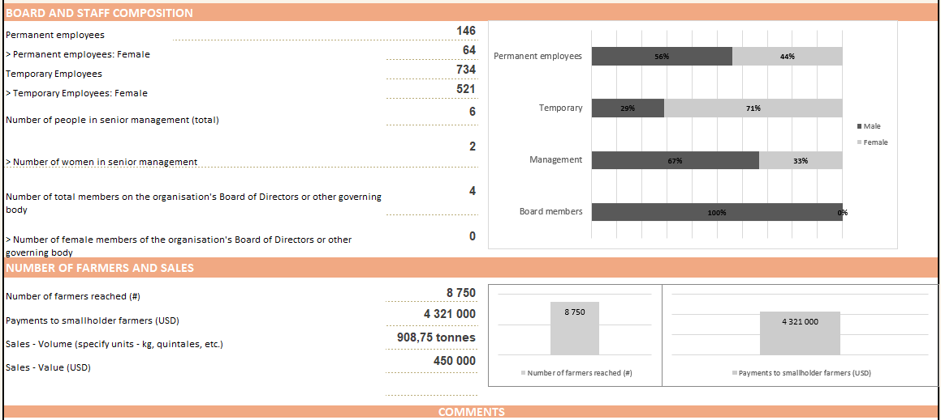
Overall Agri CP Assessment Results for [Organization Name]

Slide 6
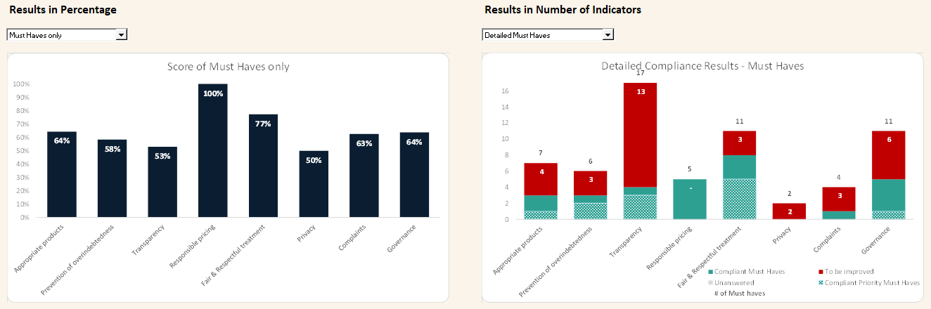
Specific Agri CP Assessment Results for [Organization Name]

Slide 7
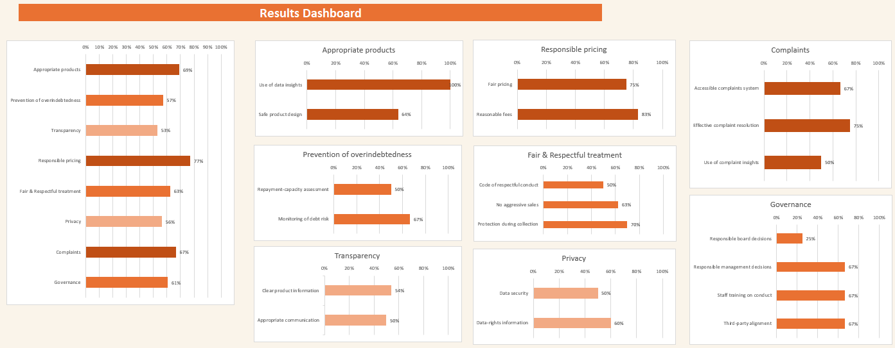
Agri CP Scores Results by Standard for [Organization Name]

Slide 8
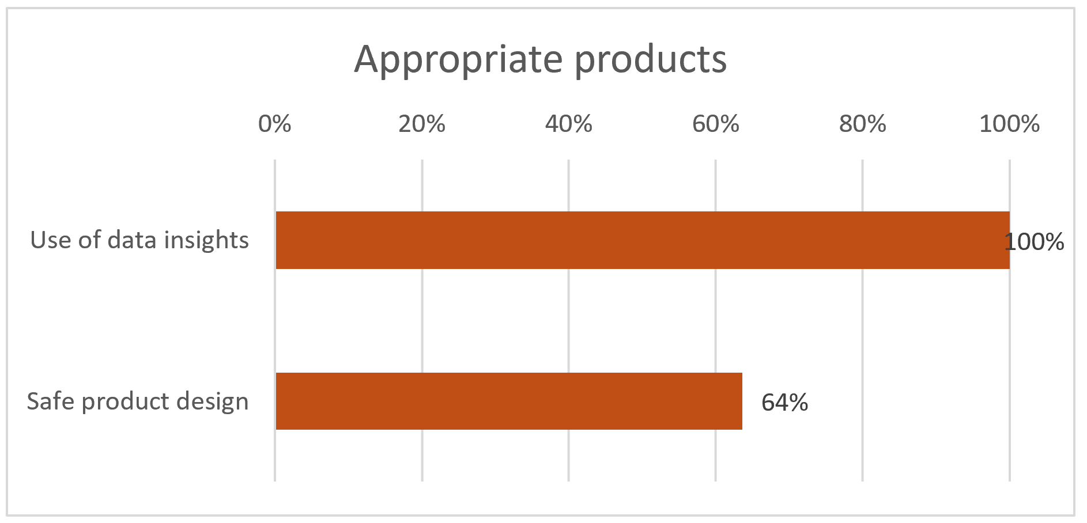
Standard 1 - The organization's products, services, and channels benefit smallholder farmers = [XX]%
This standard requires organizations to design and deliver their offerings with and for smallholder farmers, so that they create value while preventing any harm. In concrete terms, regular farmer insights and segmentation (seasonality, access and cash flow constraints) help ensure products and channels are usable and timely; without this, farmers may be offered unsuitable packages or services that arrive at the wrong moment, increasing costs and stress. Testing/piloting before deployment and monitoring usage and benefits are essential to avoid negative outcomes such as yield losses linked to delayed or poor-quality inputs, or missed service access during critical farming periods. It also requires identifying and controlling the risks of harm by product/service/channel, prohibiting aggressive sales and forced bundling that can push farmers into commitments they cannot sustain. Finally, ensuring reliable and secure channels, and guaranteeing fair quality/weight practices with clear recourse in case of problems prevent income losses and unresolved disputes that undermine trust and livelihoods.
Rationale: Standard 1 ensures that every product, service, or channel is useful, safe, and fair for smallholder farmers.

Slide 9
Standard 1 – Appropriate Products - Results
What is positive | What could be improved

Slide 10
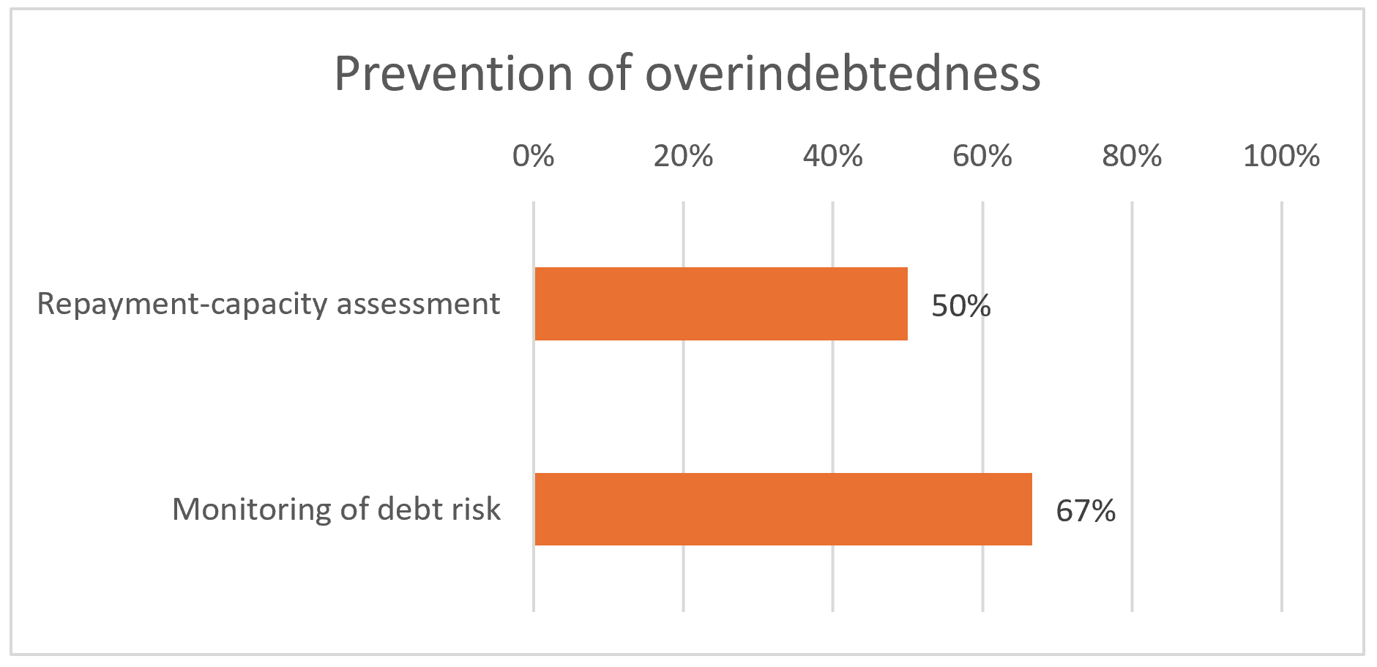
Standard 2 - The organization does not over-indebt smallholder farmers = [XX]%
This standard requires that all financing—whether in cash or in kind—be tailored to the actual repayment capacity of producers, taking into account agricultural cycles, stressed yields/prices, and other debts. The goal is to prevent situations where repayment obligations consume the income needed for food, health, schooling, or reinvestment, and where farmers are forced to sell assets or accept unfavourable terms to cope. In concrete terms, this involves an adequacy analysis (crop budgets, seasonal cash flows, debt verification via registers or alternative means), payment schedules aligned with the harvest, clear limits on deductions made from production purchase payments (so that deductions do not silently erode net income), and fair collection practices (without pressure or seizure of essential assets). In agricultural value chains, many loans are in-kind (inputs or services provided upfront) and are often repaid in kind at delivery, through automatic deductions from crop payments; the Tool is specifically designed to assess this modality and ensure deductions remain transparent, proportionate, and consistent with affordability. It also provides for early warning mechanisms and support solutions in the event of a shock (renegotiation, rescheduling), reducing the risk of debt spirals, informal borrowing, or systematic renewals that mask unpaid debts and keep farmers trapped in repeated cycles.
Rationale: Standard 2 aims for useful, sustainable, and responsible credit that protects the income and assets of smallholder farmers.

Slide 11
Standard 2 – Prevention of overindebtedness - Results
What is positive | What could be improved

Slide 12
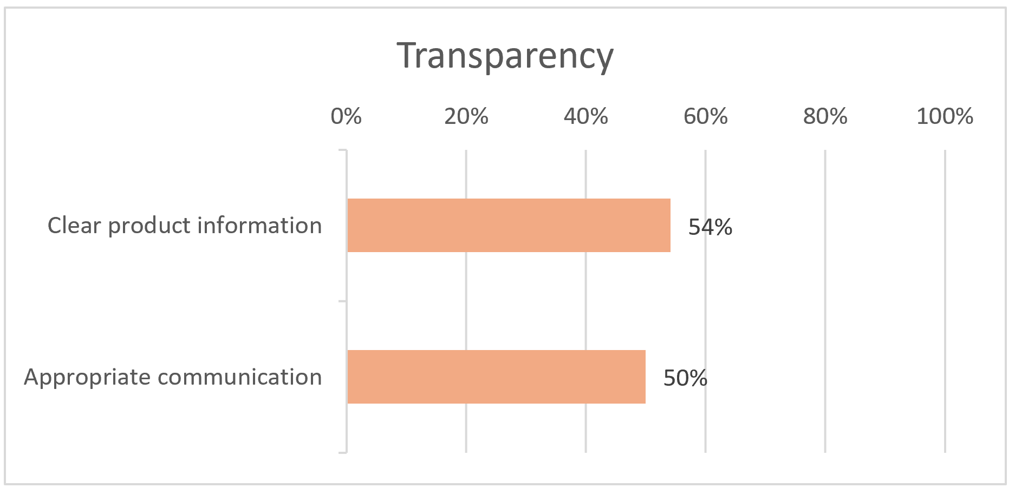
Standard 3 - The organization gives smallholder farmers clear and timely information to support farmers' decision making = [XX]%
This standard requires that producers receive all essential information in advance and in a comprehensible manner so that they can make an informed decision: terms and prices, deductions and penalties, quality/weight scales, payment/delivery deadlines, and refund terms. When information is incomplete or delivered too late, farmers may unknowingly accept conditions that reduce their net income (e.g., unexpected deductions), miss critical deadlines, or commit to inputs or services they cannot repay—often discovering the true cost only at harvest or payment time. It requires a Key Facts Statement (summary sheet) to be provided before any commitment is made, materials adapted to low literacy levels (local languages, visual/audio), and proof of delivery (signed contract/sheet, receipt for each transaction). The organization must ensure rapid updates in the event of changes in conditions, verify proper understanding, display information at service points, and systematically archive documents so that disputes can be resolved fairly and consistently.
Rationale: Standard 3 aims for practical transparency, without “surprises,” which allows smallholder farmers to make informed decisions.

Slide 13
Standard 3 – Transparency - Results
What is positive | What could be improved

Slide 14
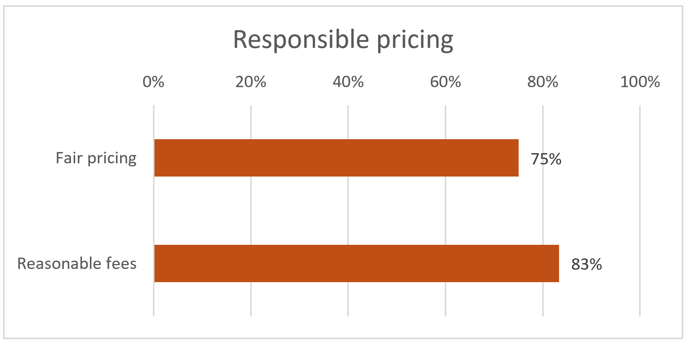
Standard 4 - The organization sets prices responsibly = [XX]%
This standard requires that prices, fees, and deductions (on inputs, services, and production purchases) be fair, transparent, and verifiable. When pricing is unclear or not controlled, farmers can be harmed through hidden costs, unpredictable deductions, or unfair grading/weights that reduce net income—often at the moment they are most cash-constrained—undermining trust and pushing households to cope through distress sales or additional borrowing. It requires a documented pricing methodology (market/regulatory references, periodic reviews); no hidden fees and no retroactive changes (clear advance notice); publication/display of price lists and communication of an anticipated net price before each transaction. For production purchases: explicit grades/quality, calibrated scales with calibration records, complaints/correction procedures, and compensation in case of error, so that payment reflects what was actually delivered. For inputs and loans in kind: fair valuation of goods/services provided, deduction limits (or written consent) and total effective cost detailed and consistent with the key information sheet, preventing “silent” overcharging through bundled services. Partners apply the same rules, without incentives that encourage abusive practices; payments to producers are made on time. The system is monitored (disputes, market deviations, internal audits/controls) and linked to the complaints mechanism.
Rationale: Standard 4 aims for fair, predictable, and controlled prices and deductions that protect the income of smallholder farmers.

Slide 15
Standard 4 – Responsible Pricing - Results
What is positive | What could be improved

Slide 16
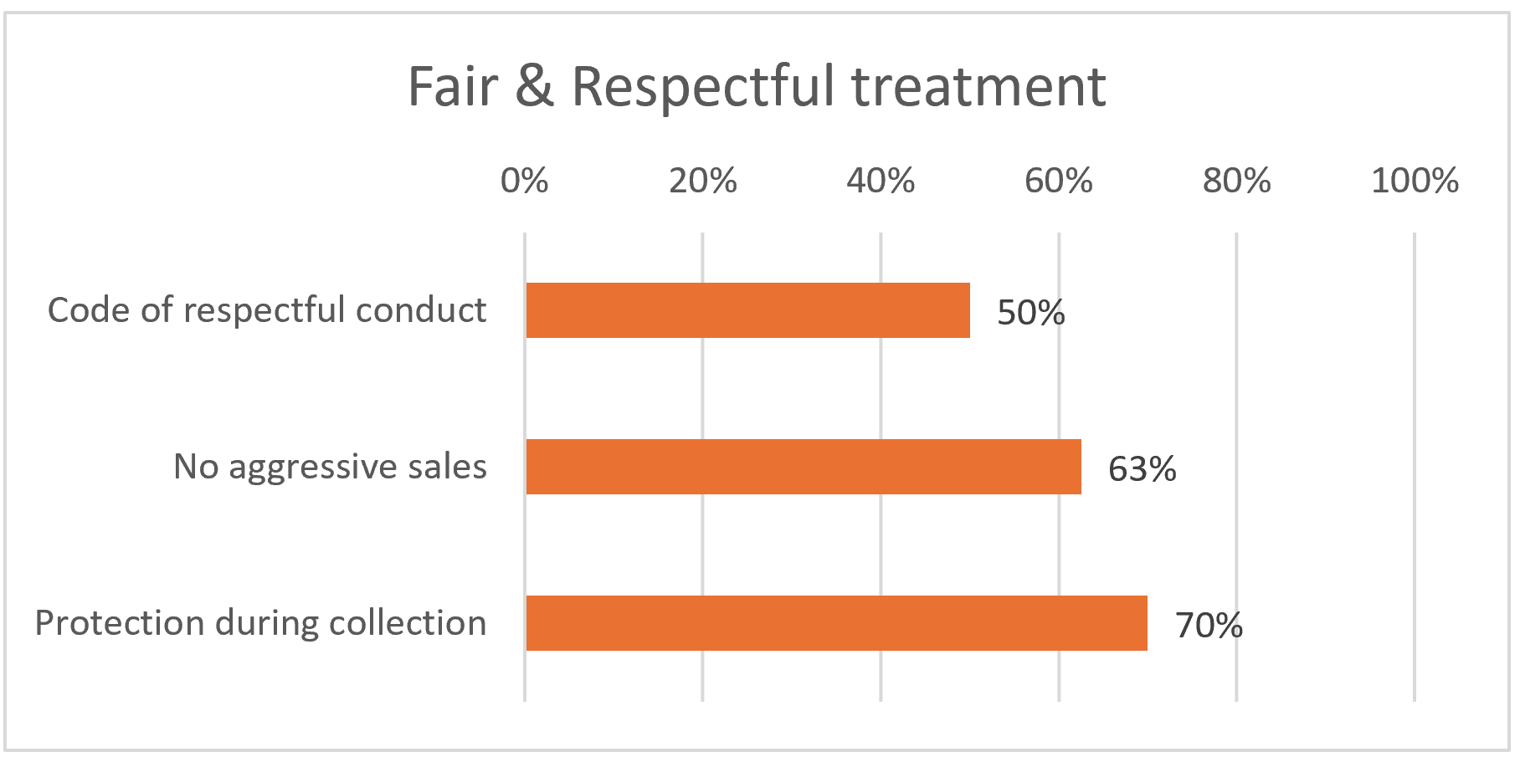
Standard 5 - The organization enforces fair and respectful treatment of smallholder farmers = [XX]%
This standard imposes zero tolerance for any form of coercion, intimidation, harassment, or abuse, and guarantees dignified, non-discriminatory relationships (gender, age, disability, origin, status) at every point of contact—farm visits, collection centers, agents, digital channels. When respectful treatment is not enforced, farmers can be harmed through pressure to sign, deliver, or repay; fear of retaliation; humiliation at service points; or exclusion of vulnerable groups, which undermines trust and can deter access to services and markets. It prohibits the retention of identity documents or essential assets, pressure to sign or deliver, and any retaliation related to a complaint. The organization implements a clear code of conduct (applicable to employees, agents, and partners), regular training, and effective disciplinary mechanisms; It secures service locations (lighting, crowd management, appropriate hours) and deploys specific GBV safeguards when the context requires it. Agents/subcontractors are contractually required to comply with these requirements and are subject to active supervision (inspections, mystery visits, complaint follow-up). Finally, incidents are recorded, processed, and analyzed to quickly correct practices and prevent their recurrence.
Rationale: Standard 5 ensures safe, respectful, and equitable interactions, which are essential for building lasting relationships of trust with smallholder farmers.

Slide 17
Standard 5 – Fair & Respectful treatment - Results
What is positive | What could be improved

Slide 18
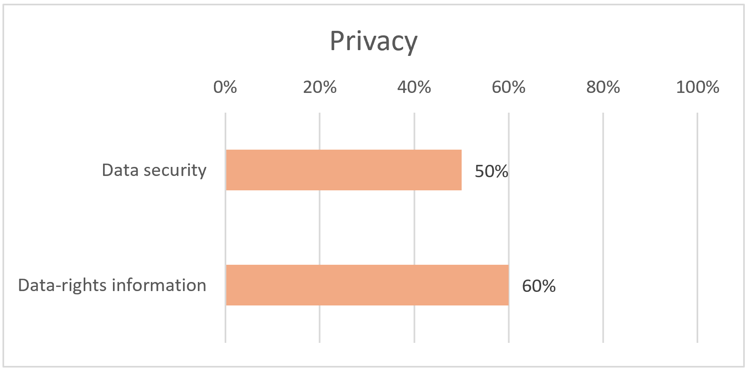
Standard 6 - The organization secures smallholder farmer data and informs them about their data rights = [XX]%
This standard requires the organization to collect and process data in a lawful, fair, and transparent manner, gathering only what is necessary for clearly explained purposes (minimization, defined retention period, secure deletion). When data is collected or shared without clear consent and safeguards, farmers can be harmed through loss of privacy, unwanted profiling, exclusion from services, fraud or identity misuse, and misuse of sensitive information (e.g., location, biometrics, financial details) that may expose them to security or reputational risks. Producers are informed simply of what is collected, why, for how long, with whom it is shared, and their rights (access, rectification, withdrawal of consent where applicable, complaint) via a privacy notice shared prior to any collection. Security is ensured by access controls (role-based rights), passwords/MFA, encryption and backups, device management (remote locking, wiping), physical storage under lock and key, and logging of access; third-party service providers/agents are covered by sharing/processing agreements limiting uses and prohibiting any unauthorized resale or transfer. Sensitive data (biometrics, precise location, financial information) is subject to enhanced safeguards. A designated manager oversees level of implementation, team training, and an incident response plan (detection, recording, notification, and remediation).
Rationale: Standard 6 guarantees secure, useful, and controlled data, and smallholder farmers who are informed and able to exercise their rights.

Slide 19
Standard 6 – Privacy - Results
What is positive | What could be improved

Slide 20
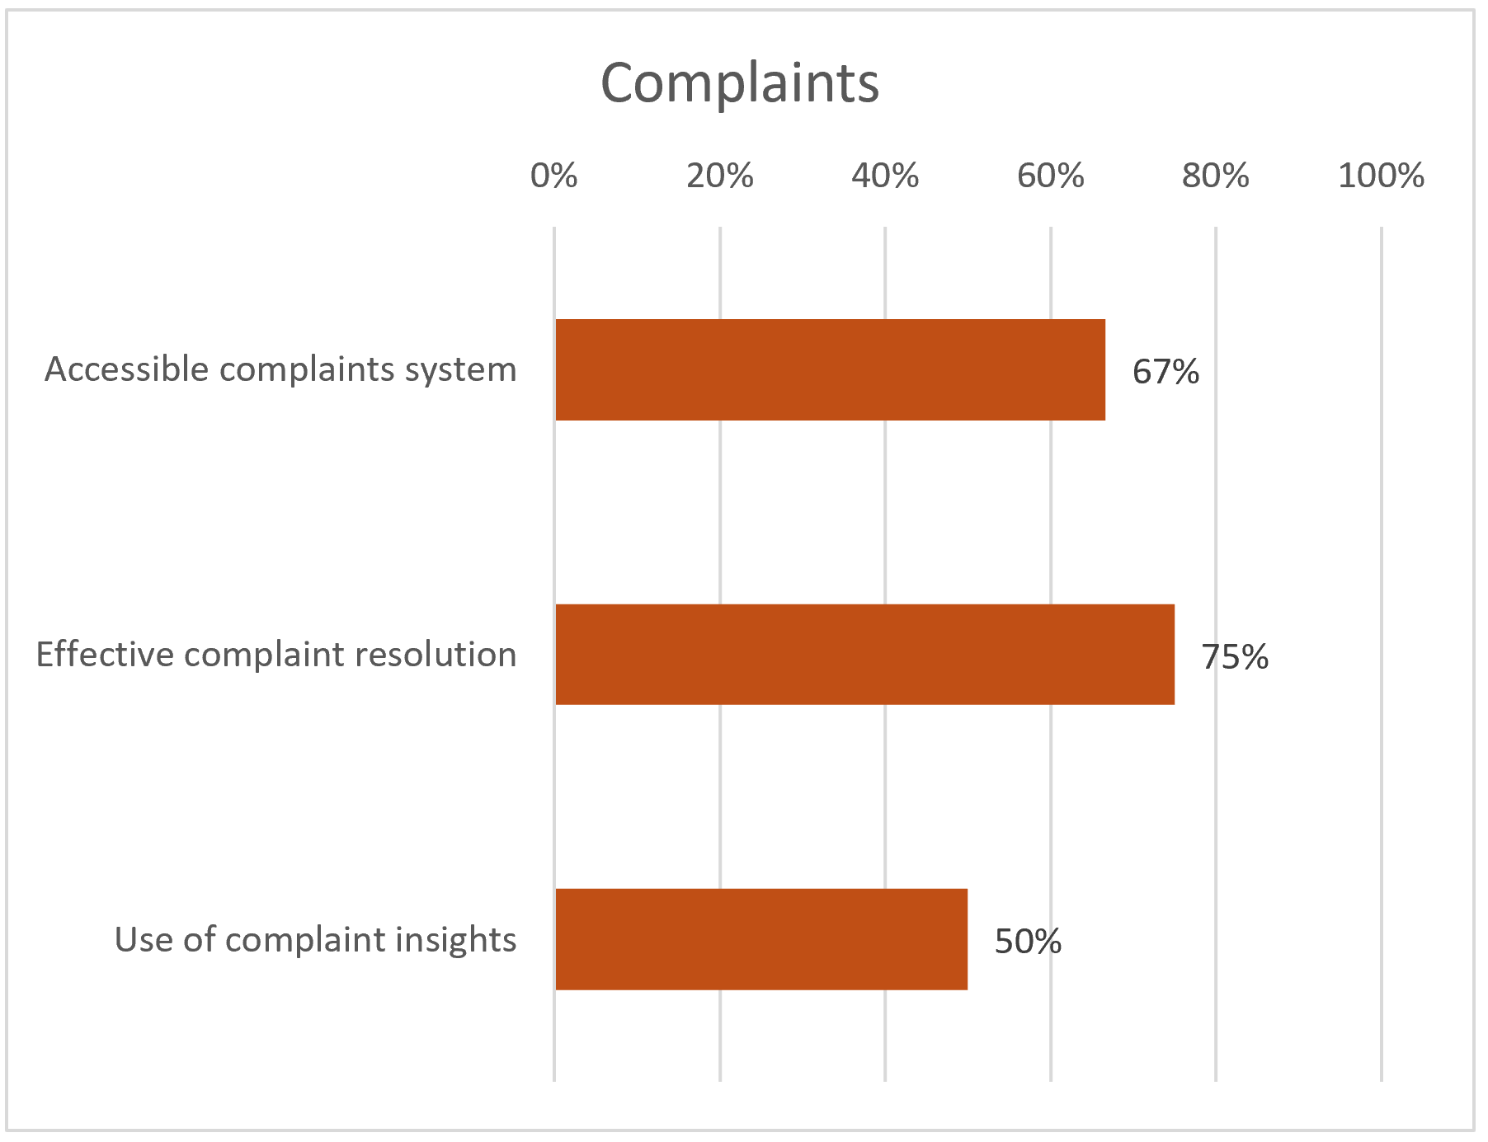
Standard 7 - The organization receives and resolves complaints related to its own operations, employees, agents, products & services from its stakeholders = [XX]%
This standard requires a secure, accessible, and trustworthy complaints mechanism to address grievances related to operations, employees, agents, products, and services, originating from smallholder farmers, local communities, and any other affected parties. When complaints are not received or handled safely, harm can persist unnoticed—farmers may avoid speaking up for fear of retaliation, problems may repeat (e.g., unfair deductions, abusive behaviour, faulty inputs), and unresolved grievances can escalate into loss of income, conflict, or reputational and legal risks for the organization. In practical terms, the organization provides several channels that are free of charge, in local languages, and adapted to low literacy levels, with confidentiality, anonymity options, and a no-retaliation policy. Decisions are notified to complainants and, in the event of harm, effective remediation is offered (correction of practice, replacement/compensation, disciplinary measures). The system also covers agents/subcontractors (contractual clauses, supervision, reporting), is visible at service points (clear signage), and is monitored by indicators, with trend analysis by the management committee and continuous improvement.
Rationale: Standard 7 ensures that any justified criticism is translated into a response and redress, while feeding into organizational learning.

Slide 21
Standard 7 – Complaints - Results
What is positive | What could be improved

Slide 22
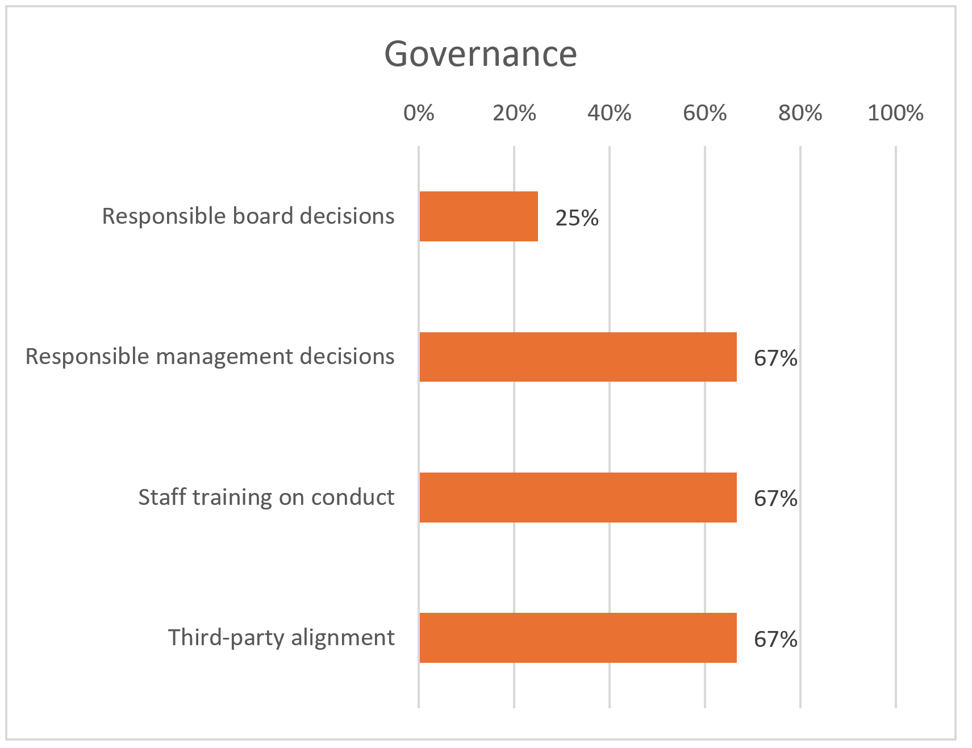
Standard 8 - The governance and management are committed to smallholder farmer protection, and HR systems support its implementation = [XX]%
This standard requires an explicit and verifiable commitment from management and the board of directors to protect smallholder farmers, translated into governance, resources, and systems. Without clear ownership, incentives, and oversight, client protection can become inconsistent—especially when services are delivered through agents and partners—allowing harmful practices (e.g., abusive deductions, aggressive sales, poor complaint handling) to persist unchecked and creating significant operational, reputational, and legal risks. In concrete terms: a policy approved at the highest level; a designated manager (with a mandate, budget, and annual plan); the integration of Agri CP requirements into strategy, risk management, committees (credit/purchasing/quality), management reviews, and internal audits. HR supports implementation through a code of conduct, contractual clauses applicable to staff/agents/partners, training (onboarding + refresh), and aligned incentives (targets that do not encourage aggressive sales or abusive deductions), accompanied by a disciplinary mechanism and an ethics alert system. Partners/agents are subject to due diligence, contracts incorporating Client Protection requirements, and documented supervision (controls, audits, corrective plans). A dashboard tracks KPIs (training, incidents, complaints, resolution times, audit closures), feeds into corrective decisions and a cycle of continuous improvement (annual review, procedure updates).
Rationale: Standard 8 ensures that the protection of smallholder farmers is driven by governance, supported by HR, and effectively managed throughout the organization and its execution chain.

Slide 23
Standard 8 – Governance - Results
What is positive | What could be improved

Slide 24
Main recommendations
[Summarize your main recommendations]

Slide 25
Action Plan
[Add a screenshot of the action plan, using this template]

Slide 26
Next Steps
[Describe the assessment next steps, if applicable]

Slide 27
[Organization / assessor logos]
Thank you for your attention!
Contact :

