Slide 1


[Organization / assessor logos]
Agri CP Tool
Client Protection Standards for the Agricultural Sector
[Organization name – Country]
Agri CP Tool evaluation presentation
[Date – by Name]
[Version: August 2026. Draft version, under development]
cerise-sptf.org

Slide 2
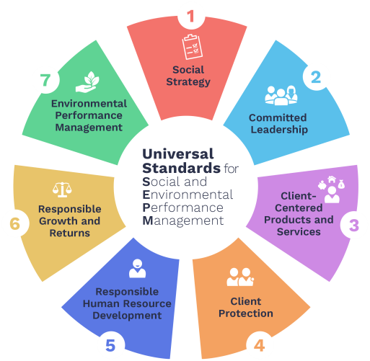


Who we are
Developing standards
A joint (ad)venture between
two of the global leaders in
social and environmental performance management
for the inclusive finance sector
Offering tools and resources

Slide 3
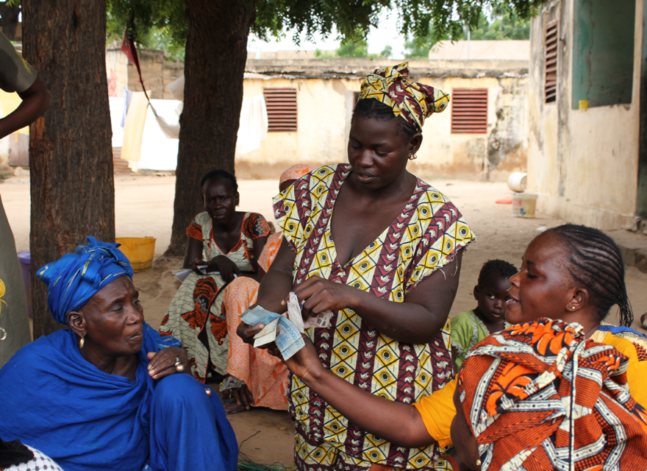
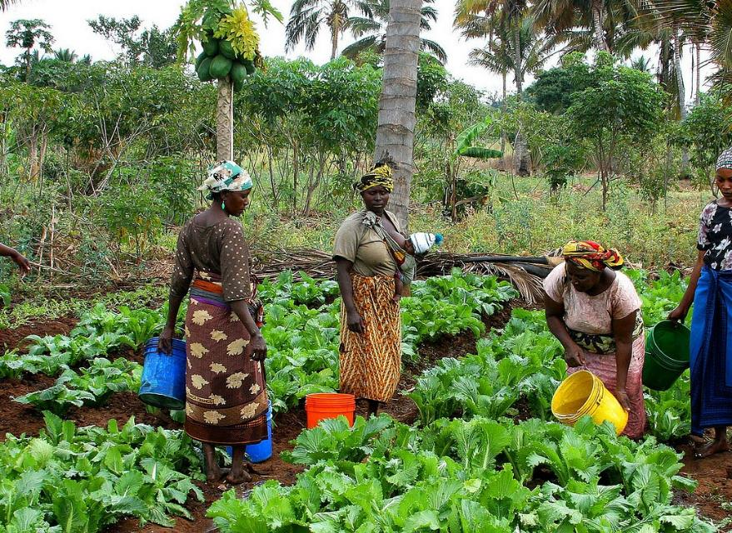
After RIF… comes RAF!
Responsible Inclusive Finance
Responsible Agriculture & Food Sector
For Financial Service Providers
For agri organizations / agri-SMEs

Slide 4
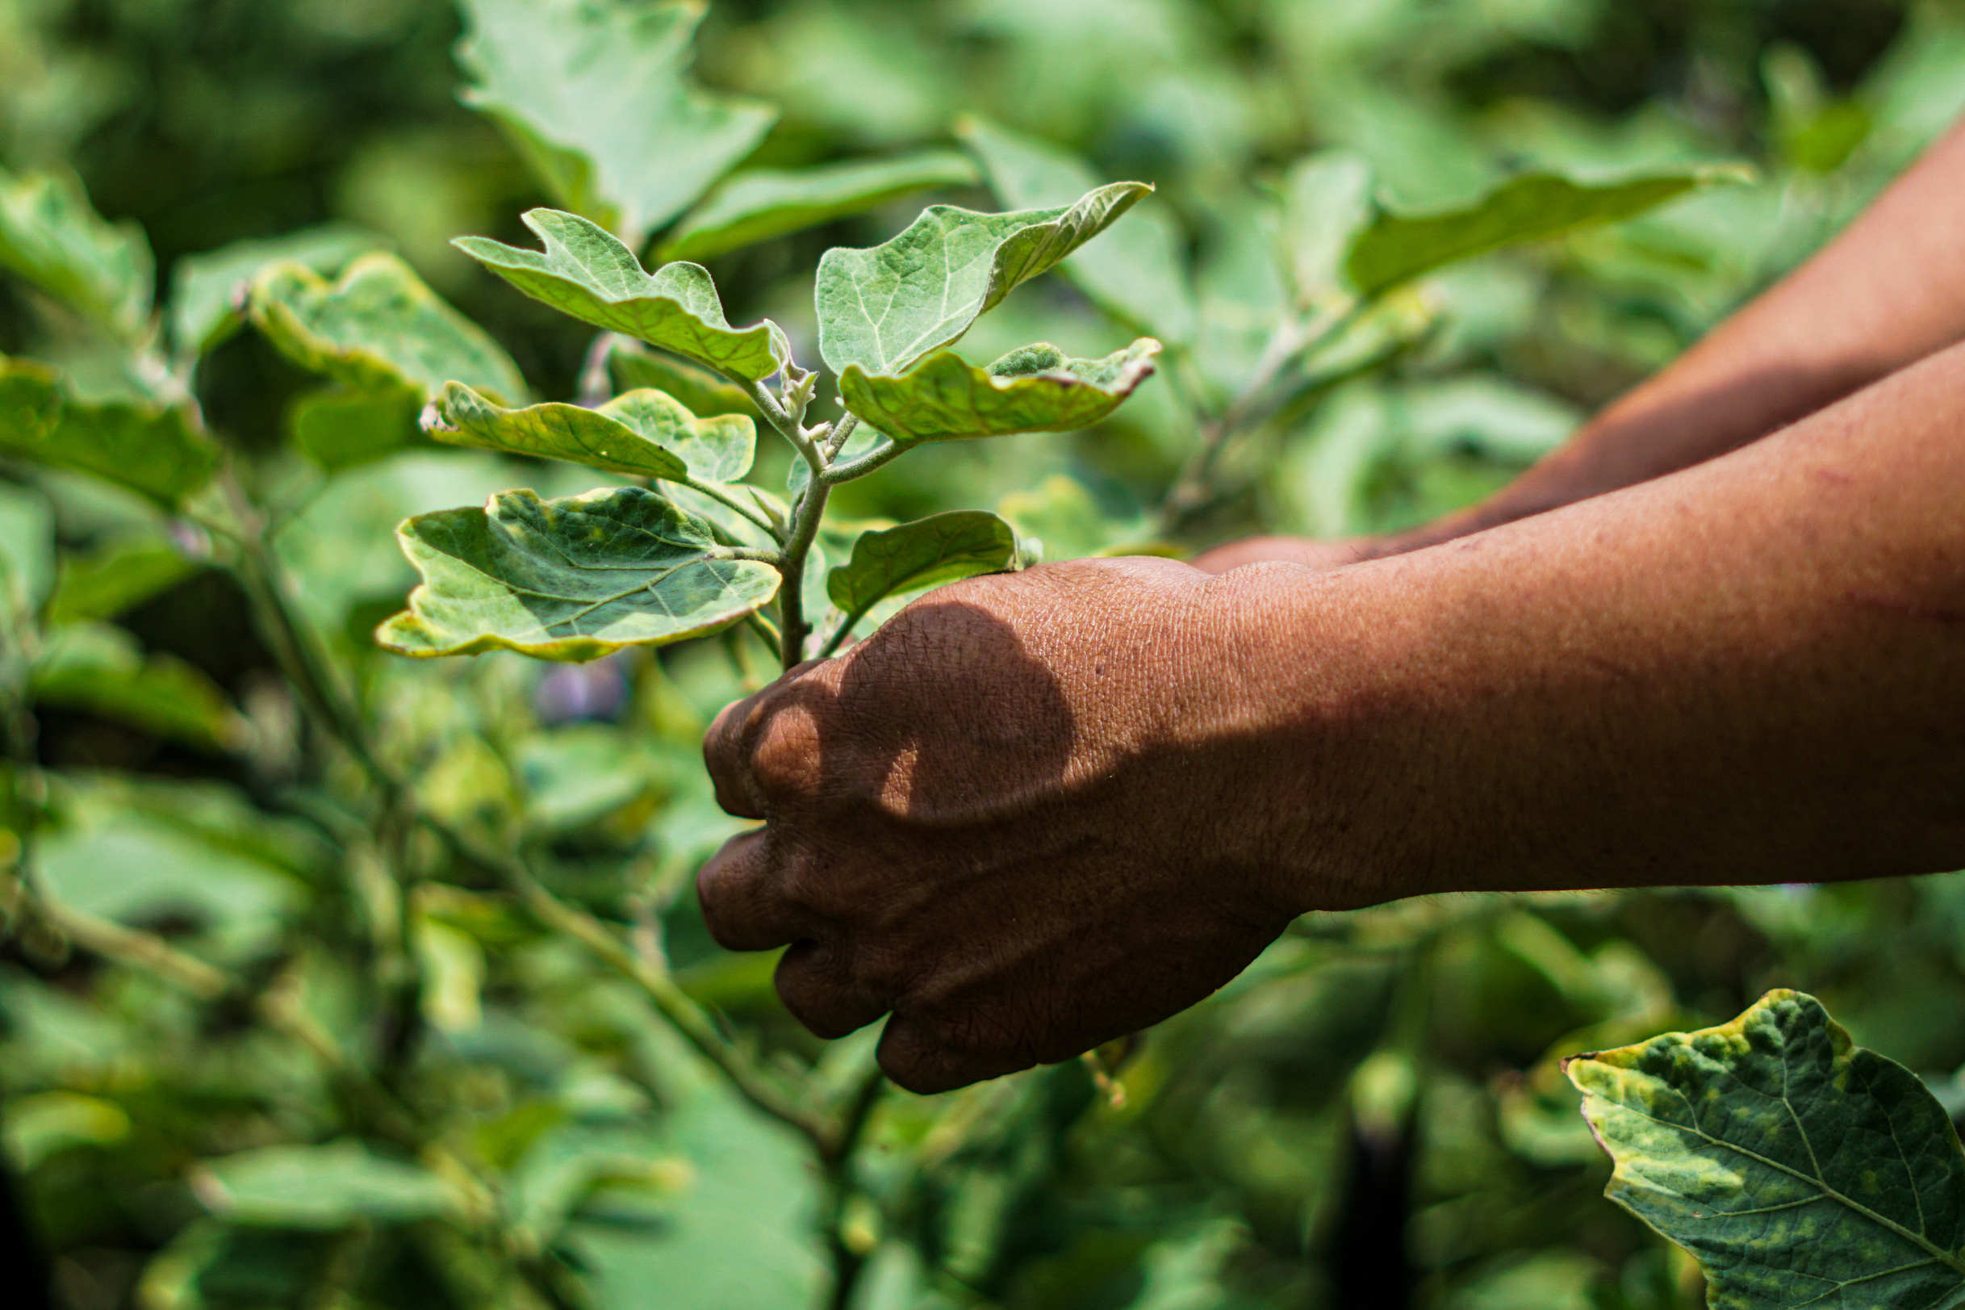
RAF Project objective
Promote a more responsible agriculture and food sector,
by equipping stakeholders with assessment and management tools and resources that integrate responsible business conduct and client protection standards.

Slide 5
Why assess your Client Protection practices?
Identify and prioritize gaps in how smallholder farmers are protected.
Reduce overindebtedness and reputational risk.
Raise awareness and built the capacity of your internal teams.
Increase smallholder farmer trust and loyalty through fair treatment.
Meet investor and lender client protection requirements.
Align with international client protection standards.

Slide 6
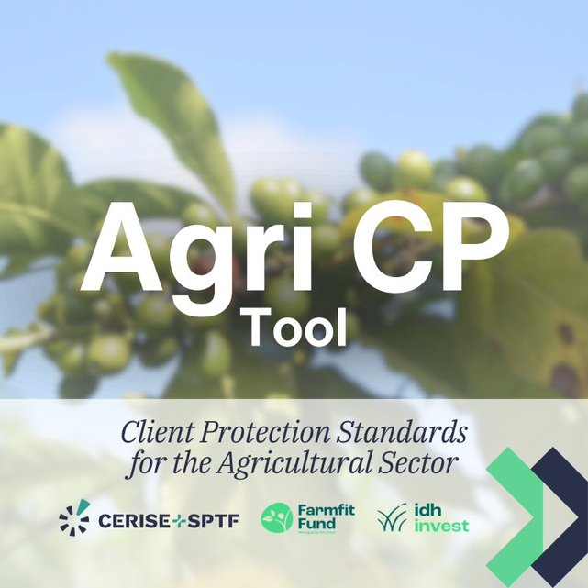
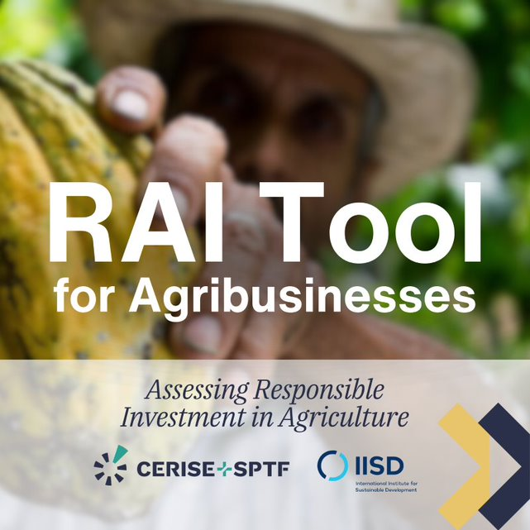
Our achievements to date
Throughout the 2022–2026 period,
Cerise+SPTF worked on developing two tools:

Slide 7
Let’s focus on…

Slide 8
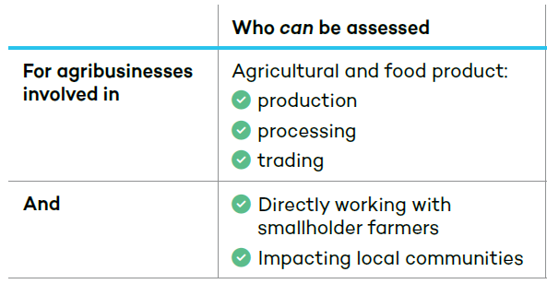
A risk-management tool for agri organizations
Agri CP Tool
Who can be assessed
For agri-organizations involved in
Agricultural and food products:
Production
Processing
Trading
Transportation
production
transformation
commercialisation
And
Directly working with smallholder farmers

Slide 9
A risk-based assessment process
Agri CP Tool
Step 1
Scope the
assessment
Step 2
Collect &
Review evidence
Step 3
Interviews &
Field verification
Step 4
Assess
Indicators
Step 5
Synthetize &
Prioritize Actions

Slide 10

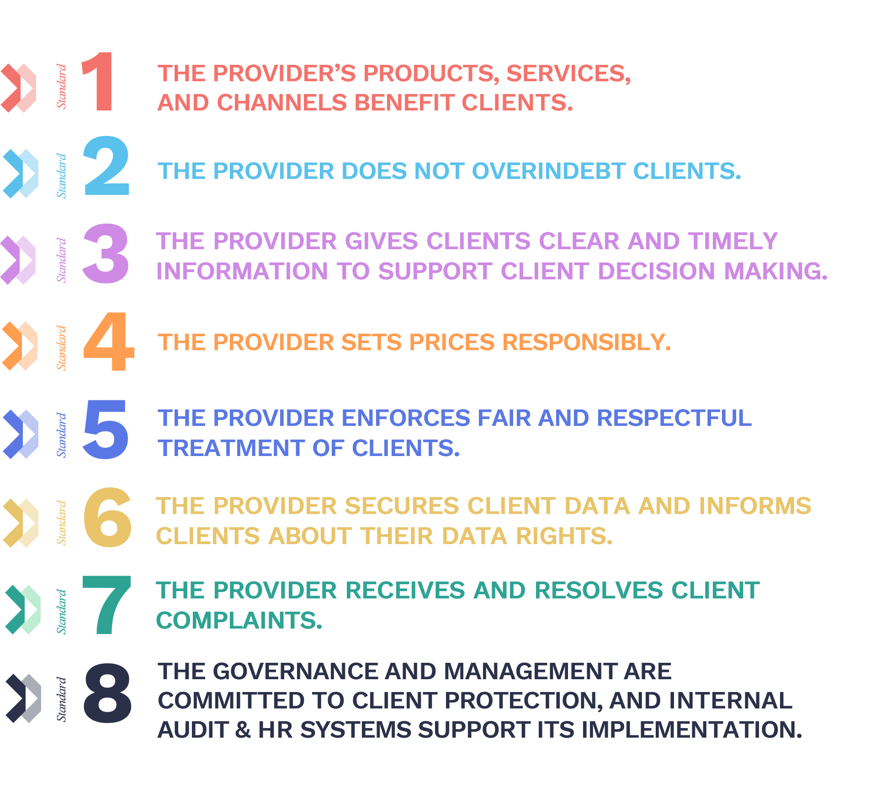

Agri CP Tool – how the tool was built
The Agri CP Tool first builds on the approach of the Universal Standards for Social and Environmental Performance and especially the Client Protection Standards and SPI tools (find out more here), key reference standards and tools developed by Cerise+SPTF for the inclusive finance sector in client protection.
A co-developed tool with IDH Farmfit Fund, a public-private impact fund, managed by IDH Investment Management, focused on smallholder farmers.

Slide 11
Agri CP Tool – Client Protection practices
To support harm prevention in commercial and service delivery relationships with smallholder farmers through 8 Client Protection Standards:
Standard | 1 | The organization's products, services, and channels benefit smallholder farmers.
Standard | 2 | The organization does not over-indebt smallholder farmers.
Standard | 3 | The organization gives smallholder farmers clear and timely information to support farmers' decision making.
Standard | 4 | The organization sets prices responsibly.
Standard | 5 | The organization enforces fair and respectful treatment of smallholder farmers.
Standard | 6 | The organization secures smallholder farmer data and informs them about their data rights.
Standard | 7 | The organization receives and resolves complaints related to its own operations, employees, agents, products & services from its stakeholders.
Standard | 8 | The governance and management are committed to smallholder farmer protection, and HR systems support its implementation.

Slide 12
Agri CP Tool – Client Protection practices
Client Protection practices are evaluated based on 8 key Standards, which are further broken down into Essential Practices and Indicators.
Standard | 1 | The organization's products, services, and channels benefit smallholder farmers.
Essential Practice
1.A. The organization uses insights from smallholder farmers' data to design products, services, and delivery channels.
INDICATOR
1.A.1. The organization collects smallholder farmers' feedback at least once every agricultural campaign, and before introducing new products or services.

Slide 13
Agri CP Tool – Indicator structure
The practices assessed through the Agri CP Tool are prioritized into Priority Must-have, Must-have, and Good Practice indicators.
Priority Must-Have
indicators
Must-Have
indicators
Good Practice
indicators
Indicators that should be reviewed and addressed first during the assessment and action planning process. They cover practices that are particularly important for preventing significant and foreseeable harm to smallholder farmers.
Core responsible practices that organizations working with smallholder farmers are expected to have in place. They are necessary to manage client protection risks effectively and consistently.
More advanced or mature practices that strengthen client protection over time. They reflect stronger systems, better monitoring, more proactive risk management, and continuous improvement.

Slide 14
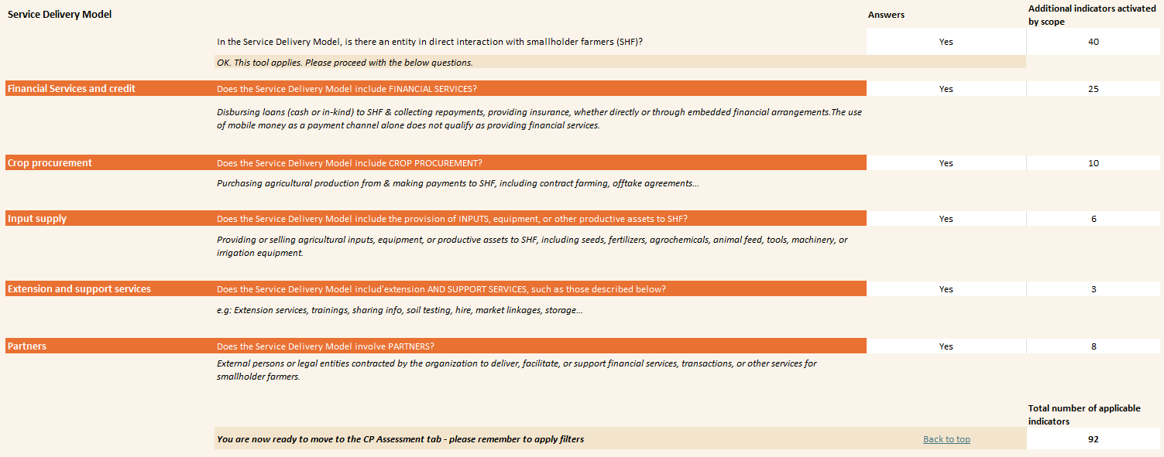
Agri CP Tool - Scoping
The Agri CP Tool allows for filtering in and out indicators based on the service delivery model of the agri-organization.

Slide 15
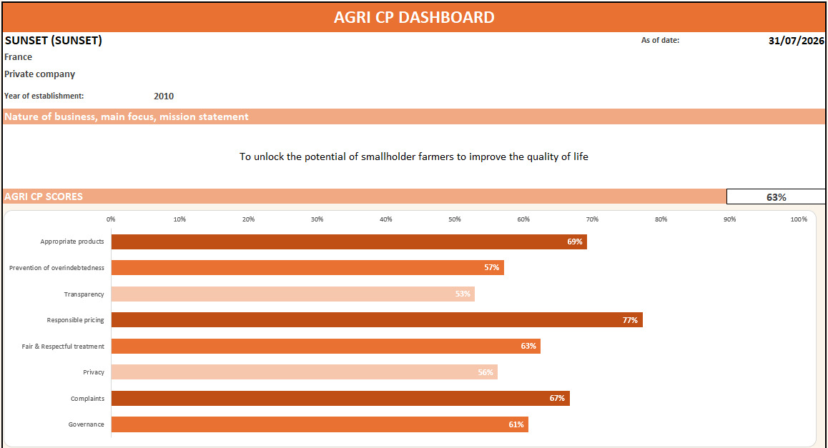
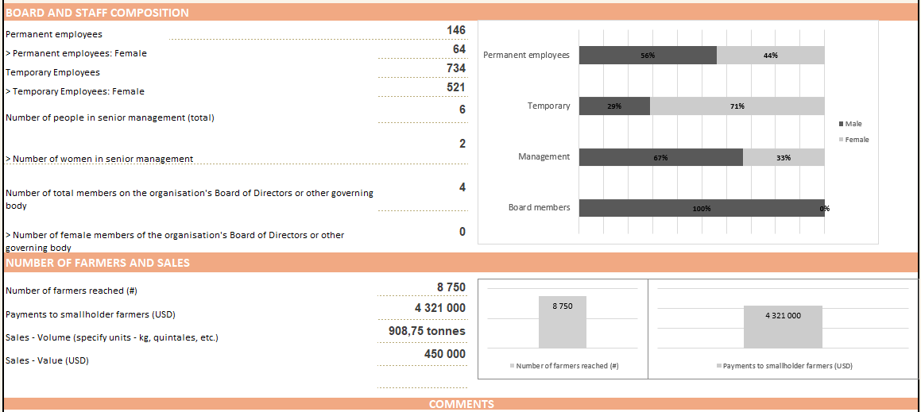
Agri CP Tool – General Agri CP Dashboard
The Agri CP Tool Dashboard provides an overview of the organization’s profile and scores by Standard along with key outputs and outcomes indicators to put the scores into context.

Slide 16
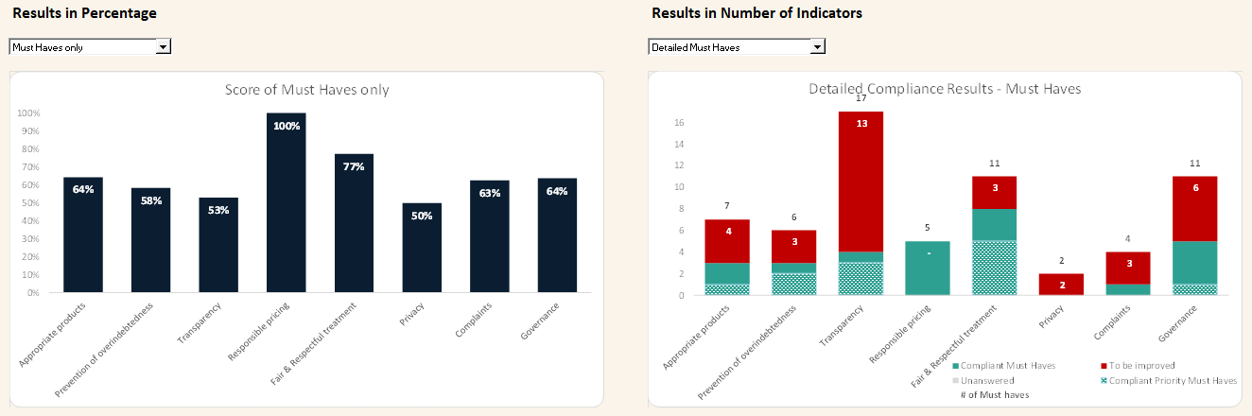
Agri CP Tool – Specific Agri CP Dashboard
The Agri CP Tool dashboard also provides a specific view of organization results in terms of Priority Must-Haves and Must-Haves, summarizing the priority improvement results to be taken into account.

Slide 17
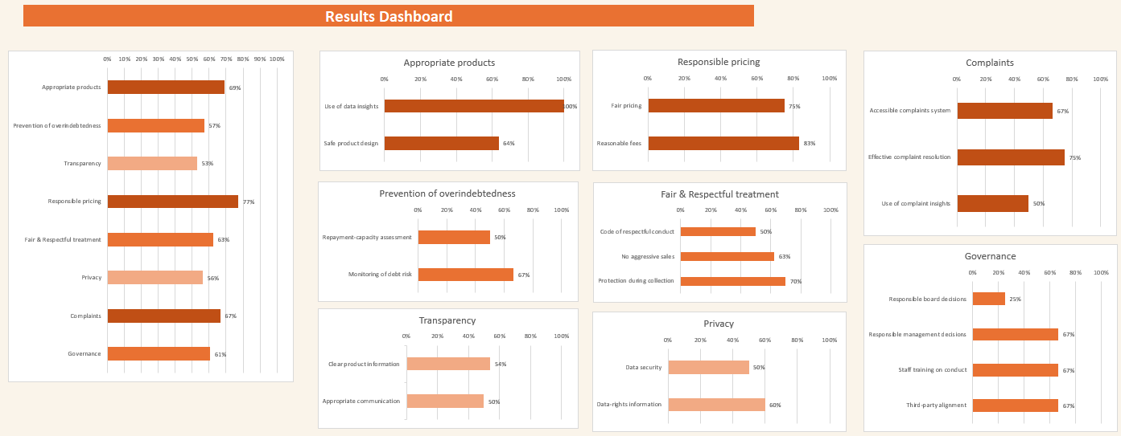
Agri CP Tool – Agri CP Scores Dashboard
The Agri CP Scores by Standards and Essential Practices provides a more detailed view of the client protection performance of the organization and helps identify key gaps to be addressed.

Slide 18
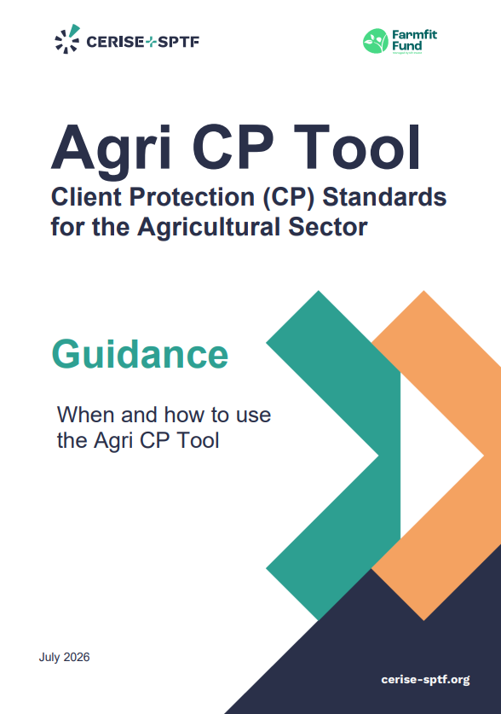
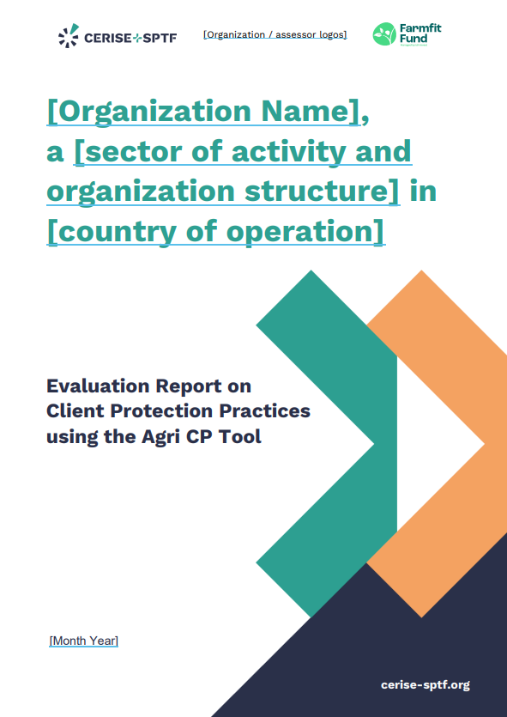
Agri CP Tool – Field Tests and Resources
Existing Resources (English / French / Spanich) :
Excel Tool + Tool Guidance
+ Evaluation Report Template
Agri CP case studies
Coming soon!
They are currently
under development.

Slide 19
Agri CP Tool – Feedback from the field
  EDFI / AGRIFI – due diligence with AgTech & Off-Taker Organizations in Ghana
The full questionnaire is a valuable resource to train less experienced investment officers on which questions to ask during the field visit.

Slide 20
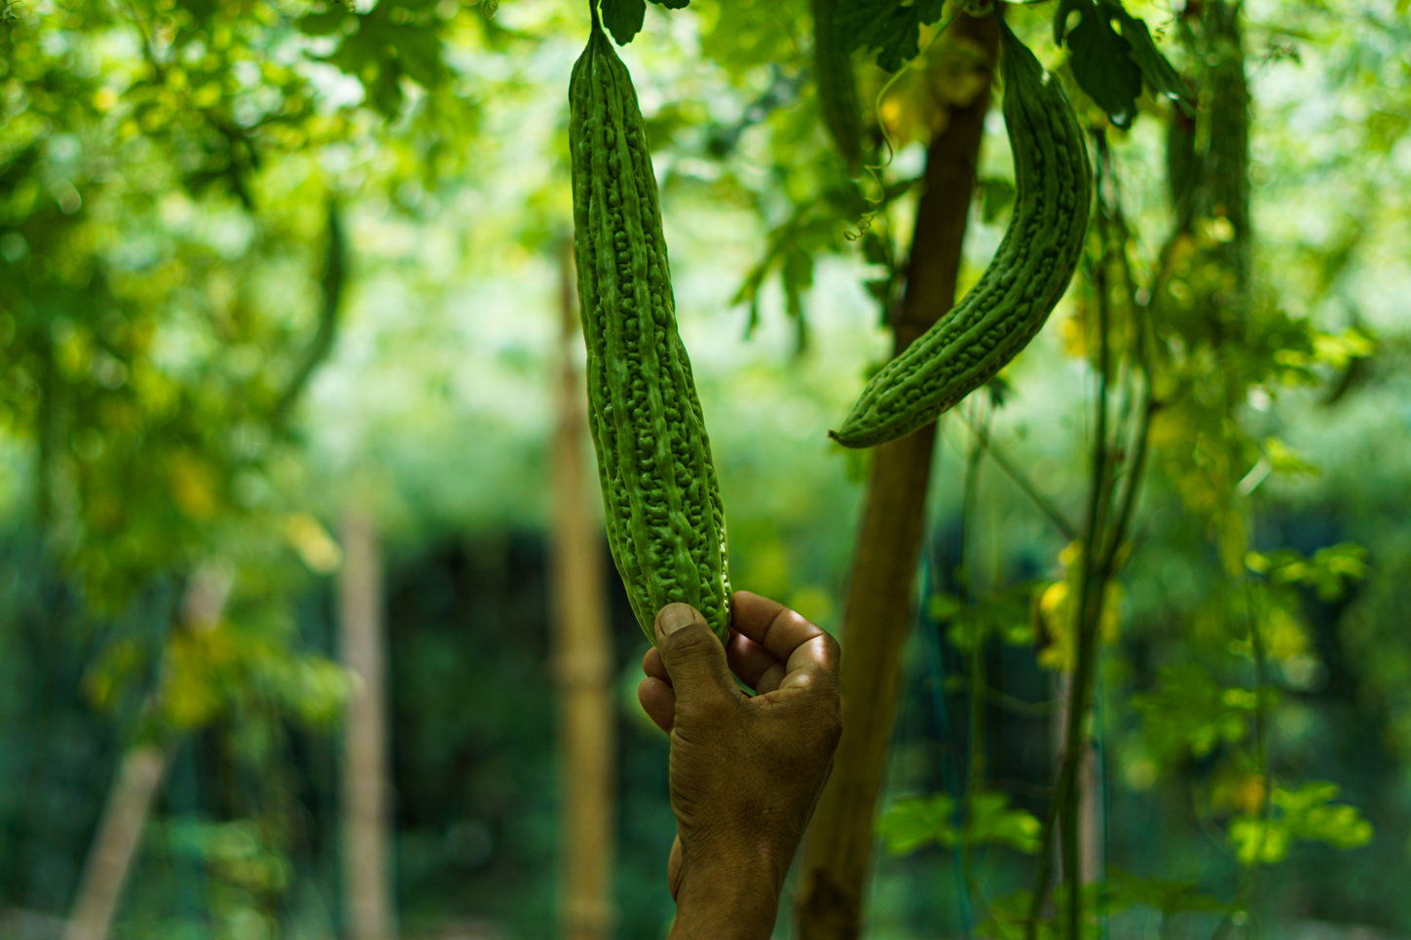
Assessment Methodology
Excel document to be completed
Off-site review of documents
Interviews with the board of directors, management, staff, and a sample of clients
Review of client files
Review of data from the Management Information System
Closing meeting to present the main findings and any recommendations

Slide 21
Agri CP Tool – Assessment Process
Depending on your availability, ideally between [start and end dates].
In general, an Agri CP assessment takes 10 days for the consultant and between 2 and 3 days for the agri organization.
Assessment Preparation
Introductory Workshop
Interviews with teams
Field
Visits
Results review and sharing
Action
Plan
Remotely
Day 1
on site
Days 2-3-4
on site
Day 3 or 4
on site
Day 5
on site
Remotely
1-hour call to share key documents
2-hour meeting with the interested teams
4 to 8 people participating for 45 minutes each
Interview with the field teams & potential support during the field day
1 to 2-hour workshop with interested teams
1-hour call if necessary

Slide 22
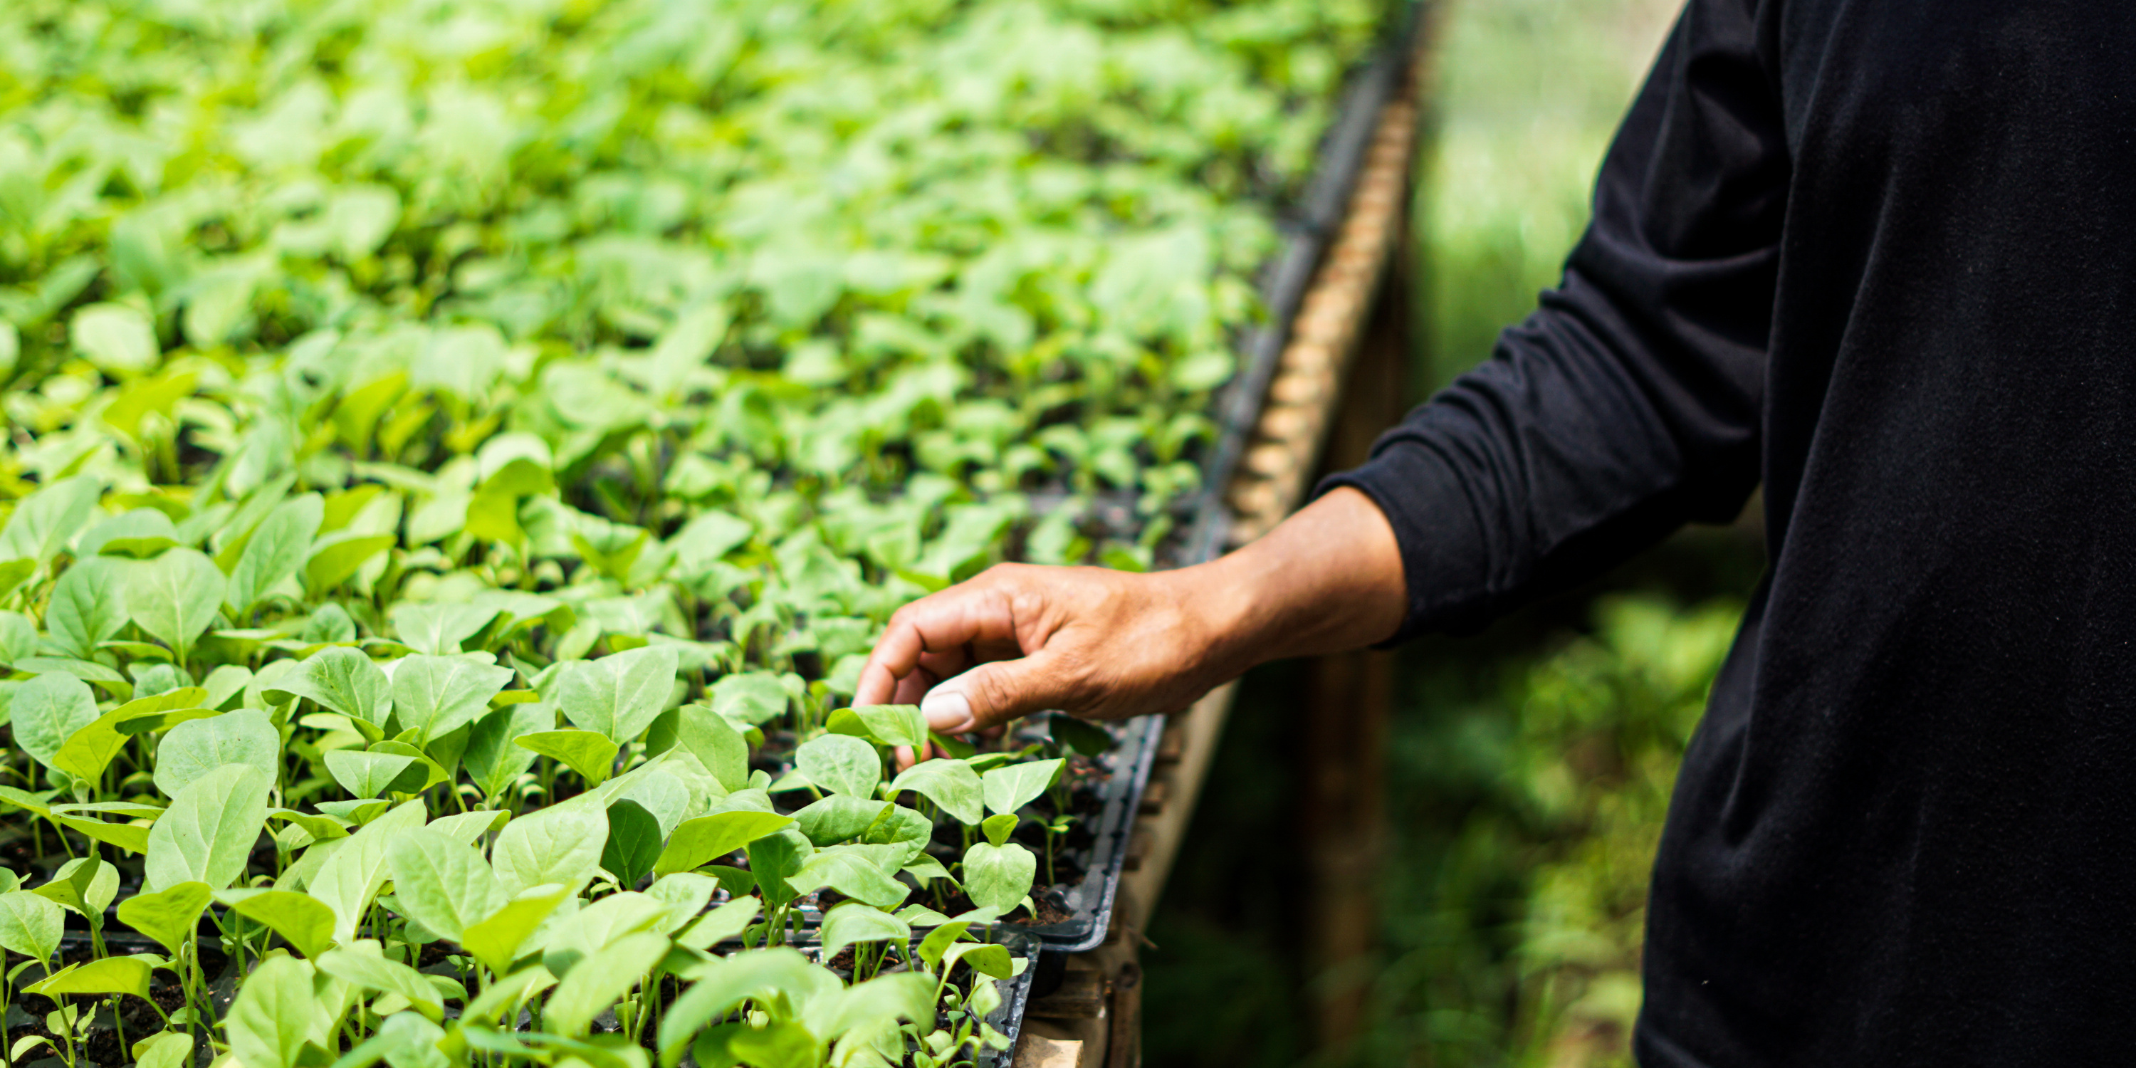
Assessment by experts
[detail who is conducting the assessment, who are the partners and eventual involved investors]

Slide 23
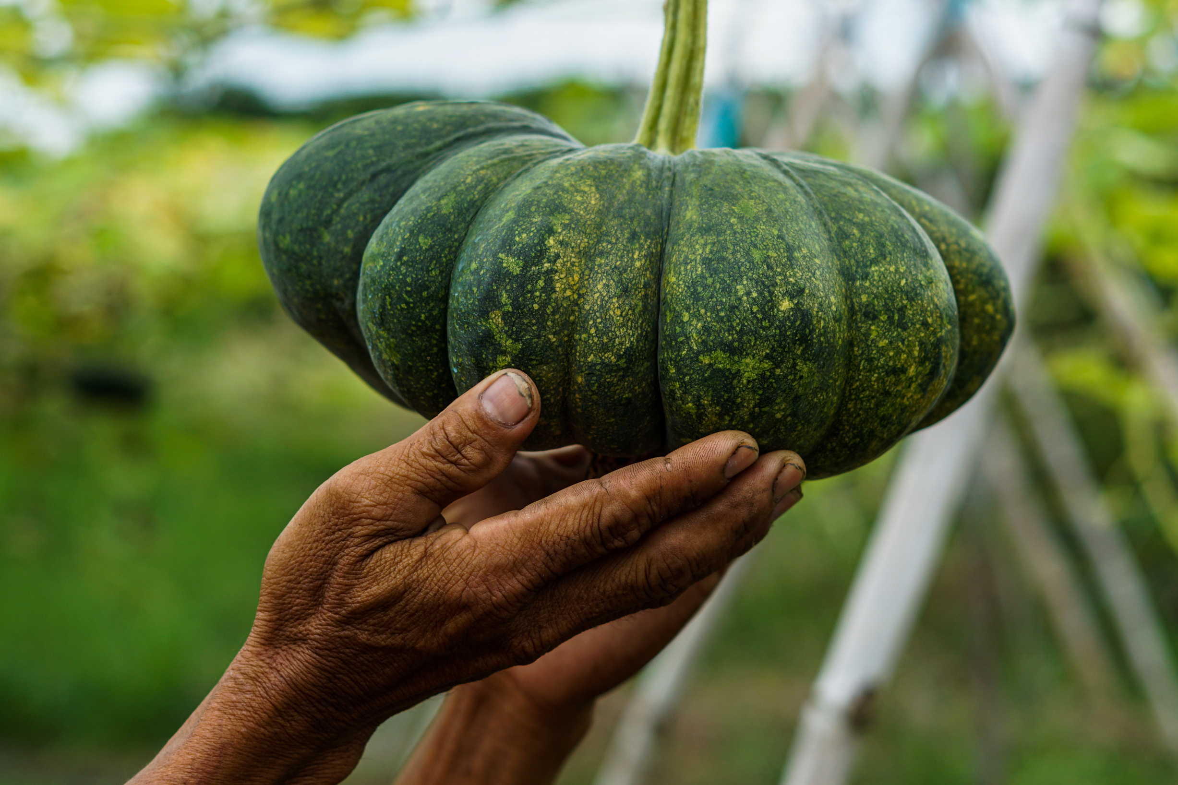
What you will obtain at the end of the assessment
Agri CP Tool completed with the results dashboards;
A narrative audit report containing the consultant’s findings and recommendations;
An action plan to help you improve your practices and procedures.

Slide 24
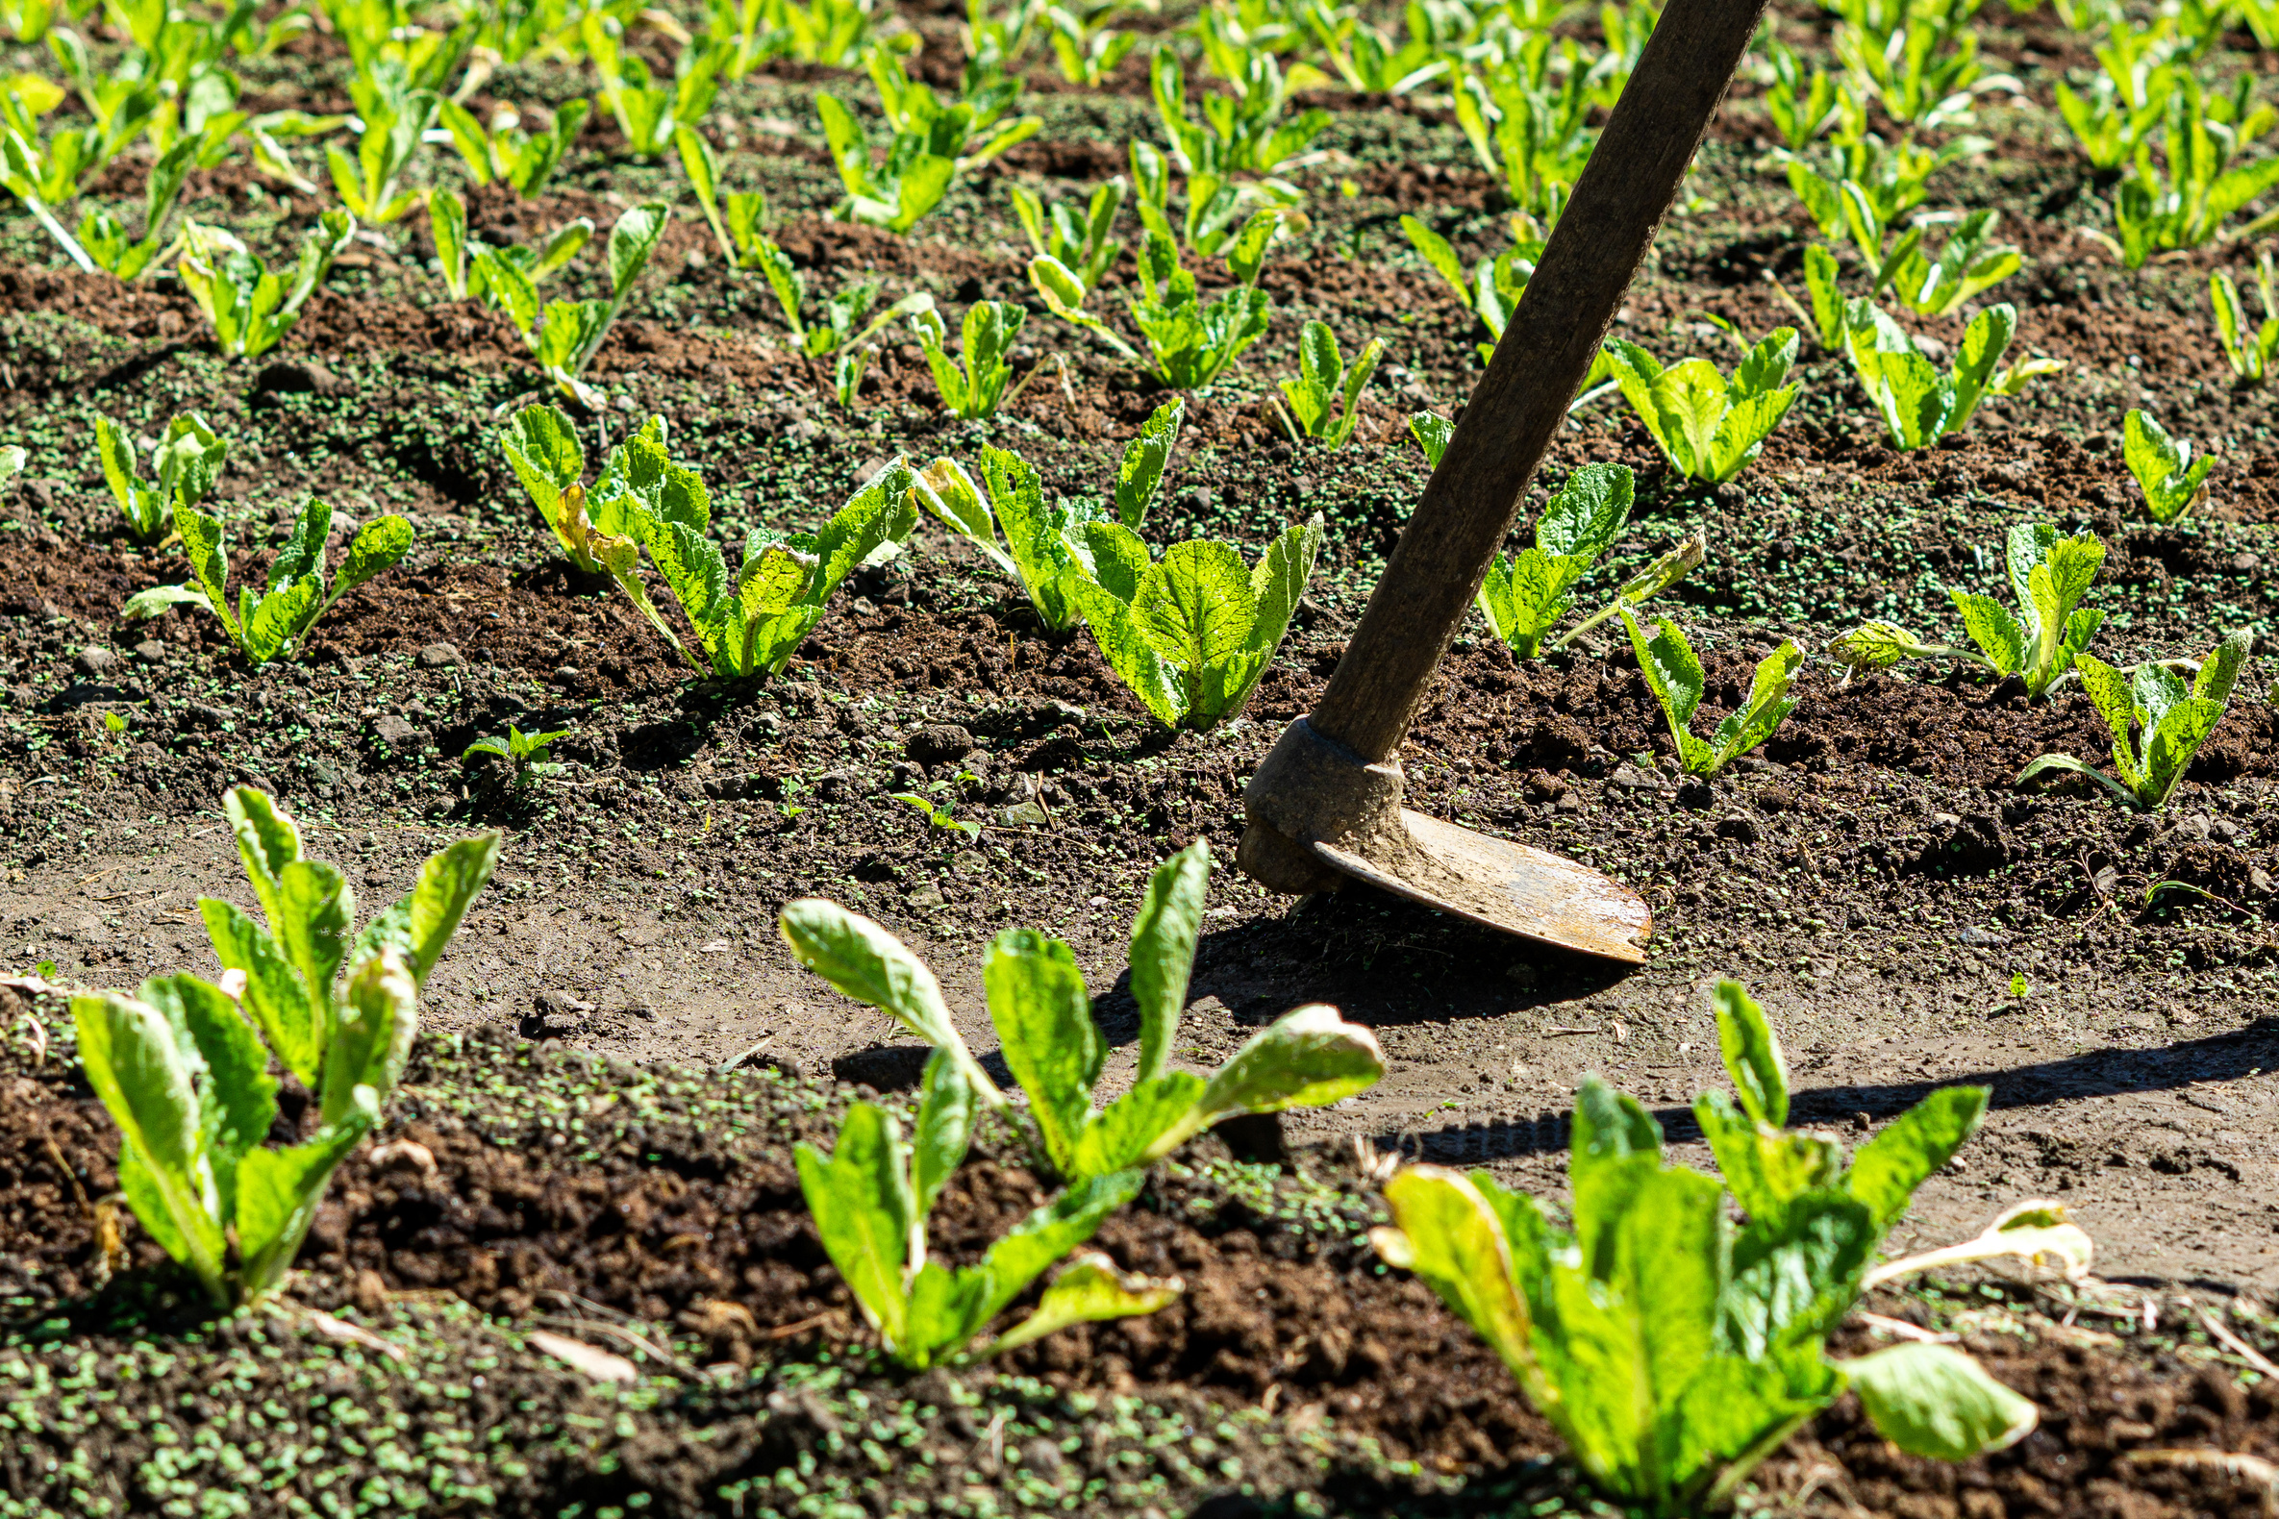
Calendar
Assessment preparation: [from DD/MM/YEAR to DD/MM/YEAR]
On-site assessment: [from DD/MM/YEAR to DD/MM/YEAR]
Final Report preparation: [from DD/MM/YEAR to DD/MM/YEAR]
The consultant will provide a detailed schedule for the on-site assessment as soon as possible.

Slide 25
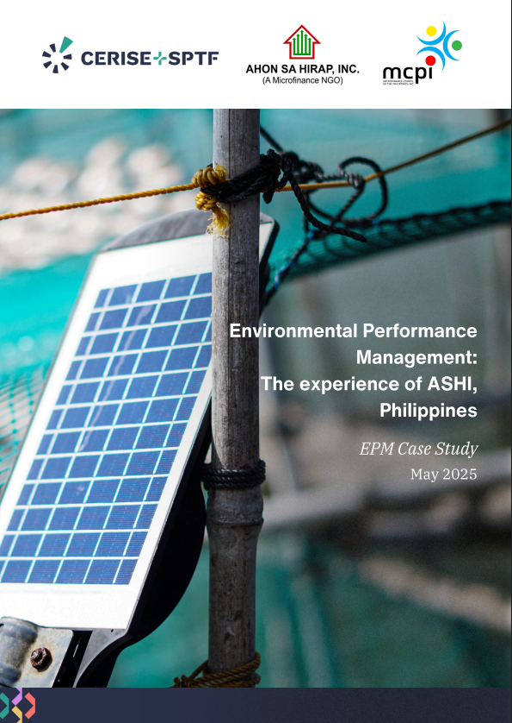

Sharing Results
[If a case study is discussed with a partner, notify the agricultural organization to obtain its approval]

Slide 26
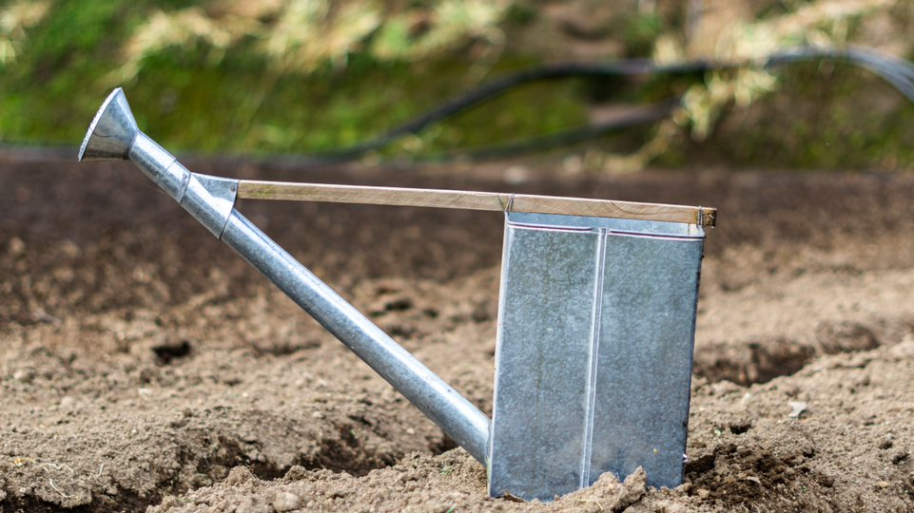
Questions / Feedback

Slide 27
Next Steps
[detail the next immediate steps to organize and conduct the assessment]

Slide 28

Explore our tools and resources
RAI Tool
Agri CP Tool
RAF Project

Slide 29
[Organization / assessor logos]
Thank you for your attention!
Contact :
Photos : Maxence Soulet

